Slide 1
DEVOPS CAPSTONE : PROJECT I

Slide 2
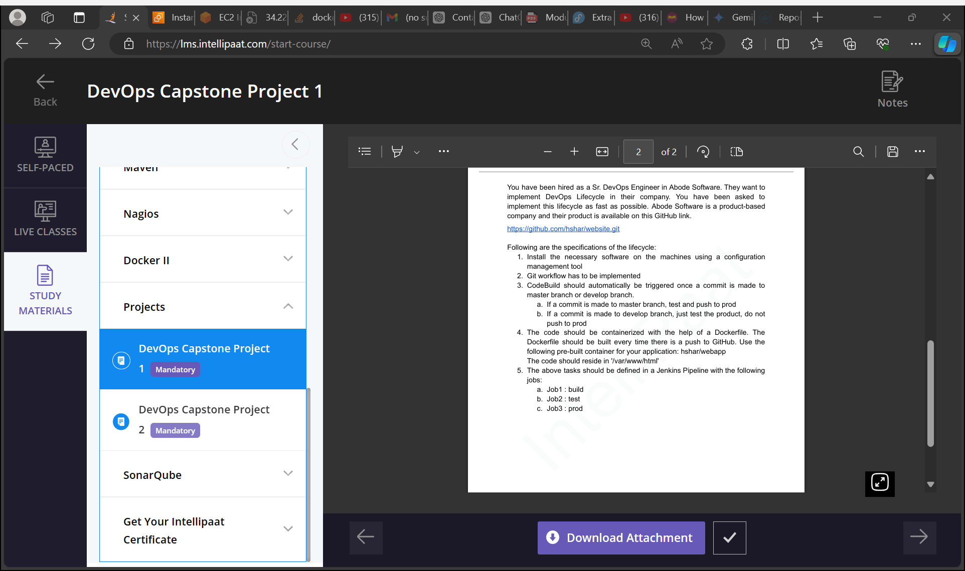

Slide 3
GitRepository
MASTER VM
Test VM
Prod VM
Install Ansible
Install Jenkins
Install Java
Install Docker
Install It should run with dockerfile on develop branch
Job2: It sjould run with dockerfile on master branchJava and Docker
Job1:
Install Java and Docker
Job3: final job of publishing over job2, if job2 is successfully running the only job3 will run, otherwise not

Slide 4
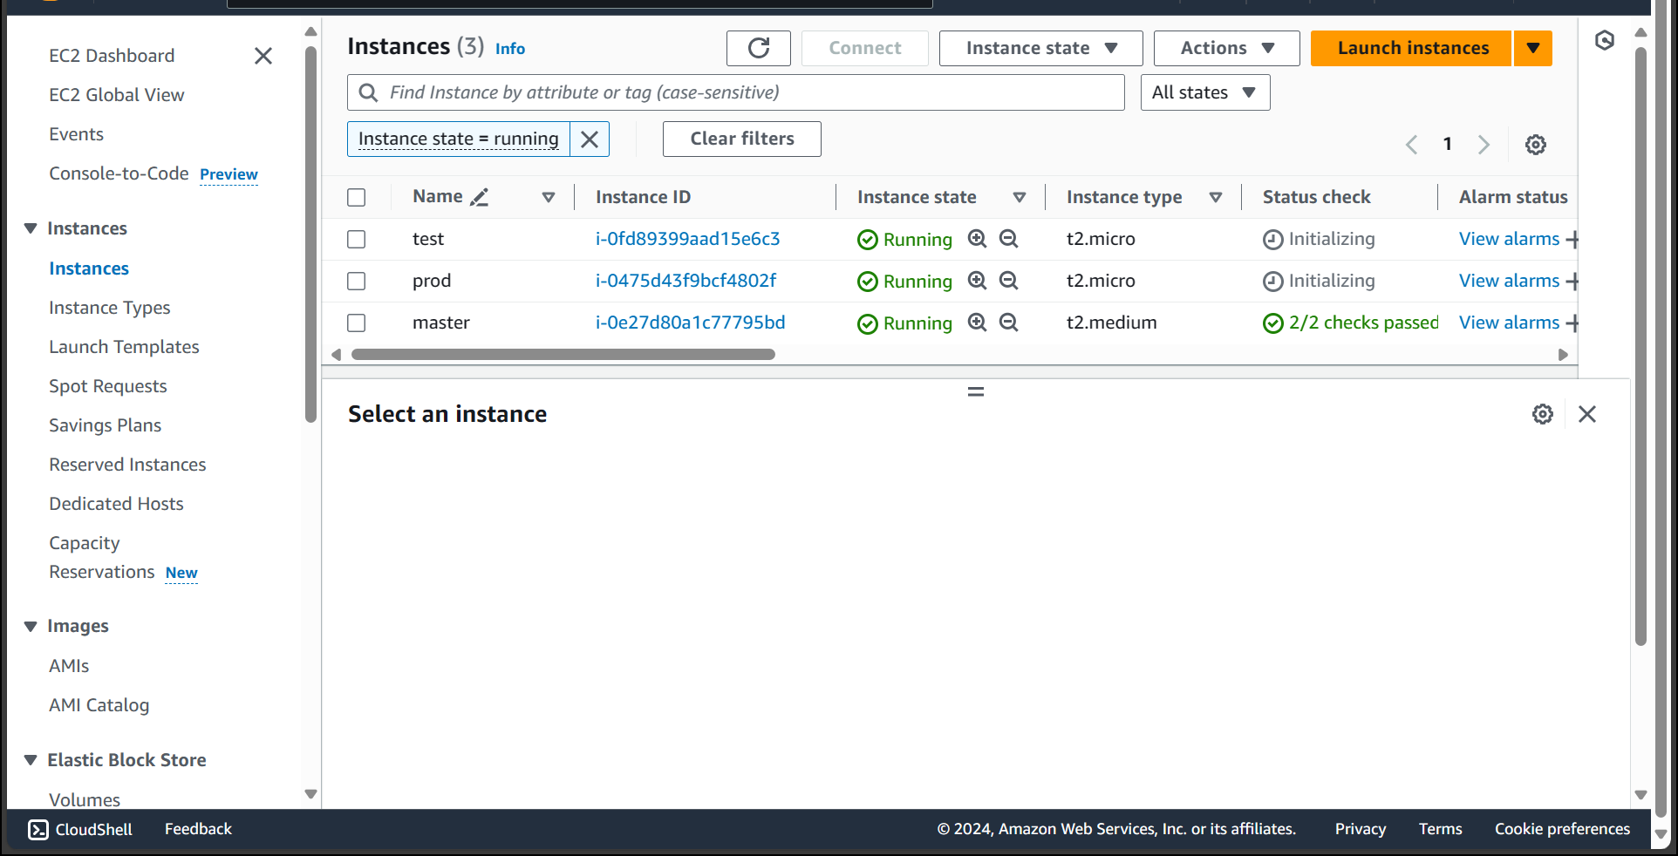
Creating Instance Master , test and prod

Slide 5
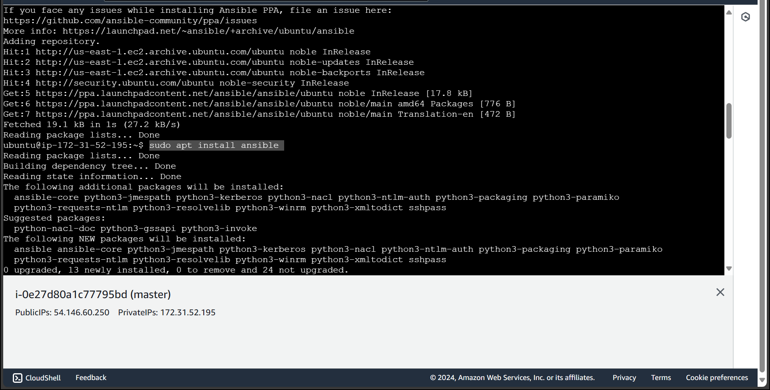
Installing ansible in master instance

Slide 6
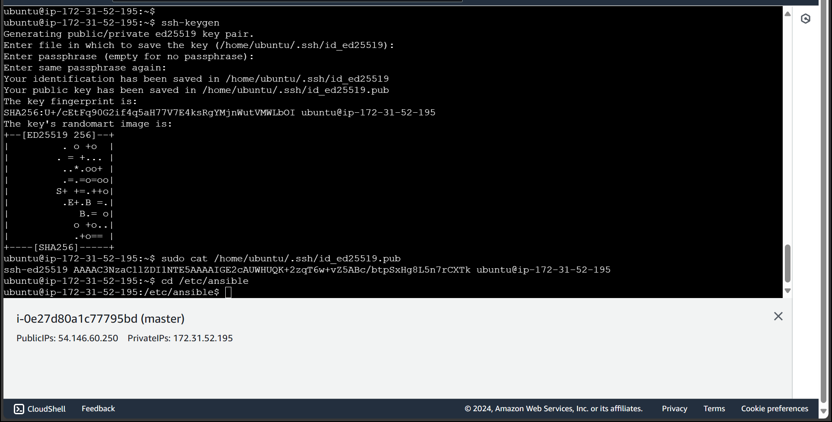
Generating Ssh-keygen to get public key to get connect with test and prod instance

Slide 7
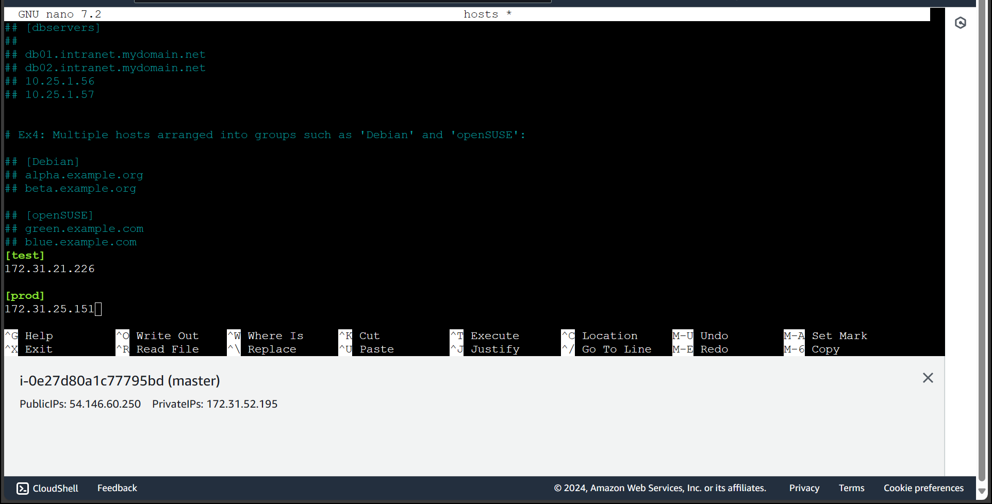
Open hosts file to add the hosts i.e. test and prod

Slide 8
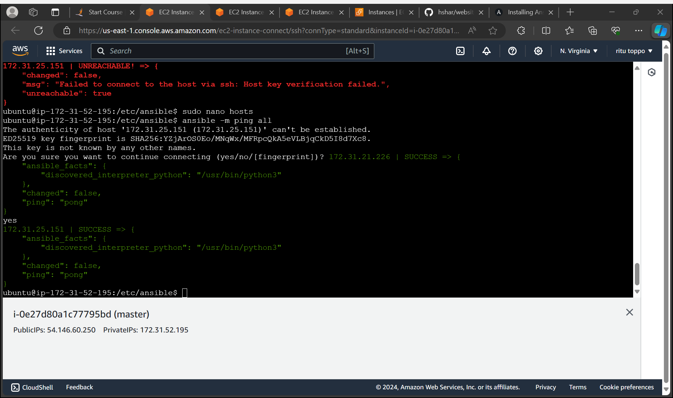
Connection to master, test and prod has been done successfully

Slide 9
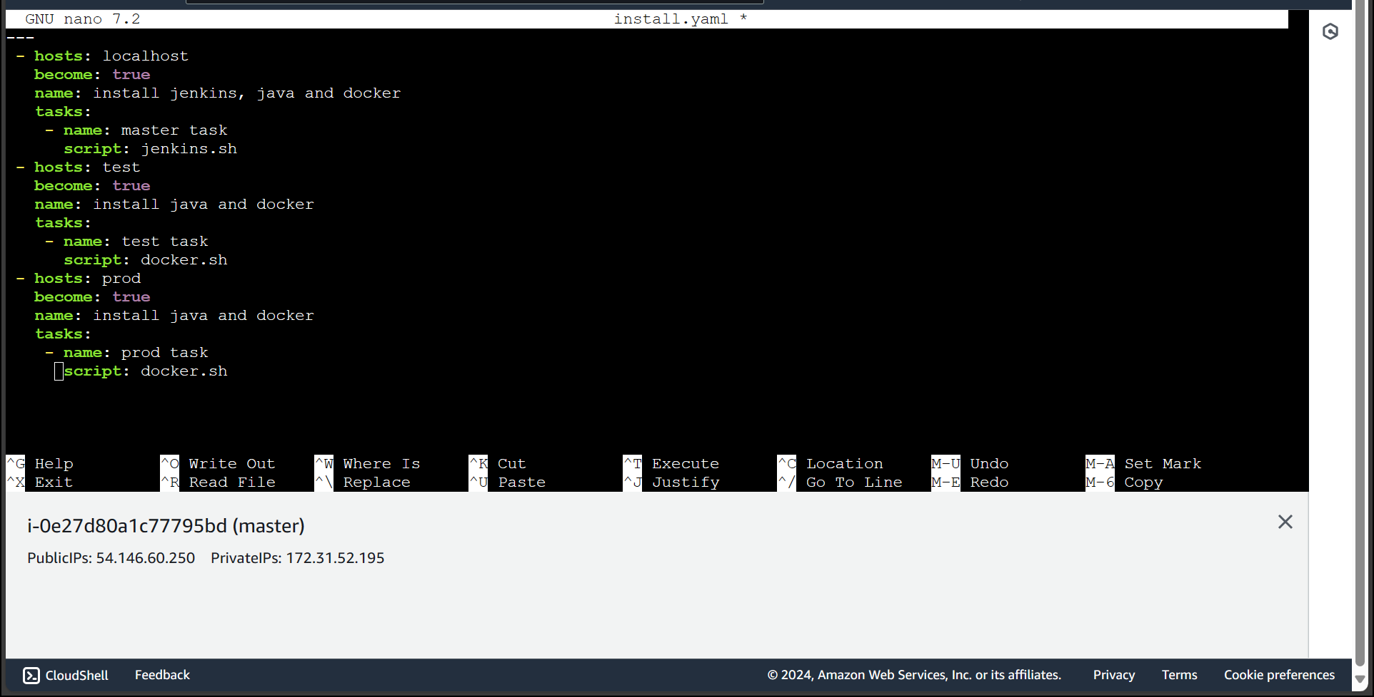
Installing the Jenkins java docker in master and java docker in test and prod instance using playbook

Slide 10
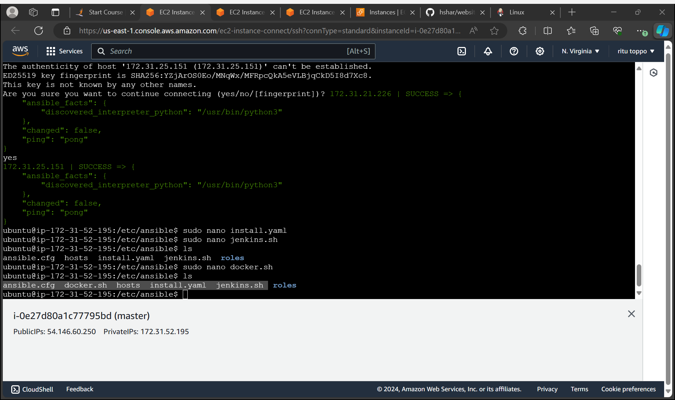
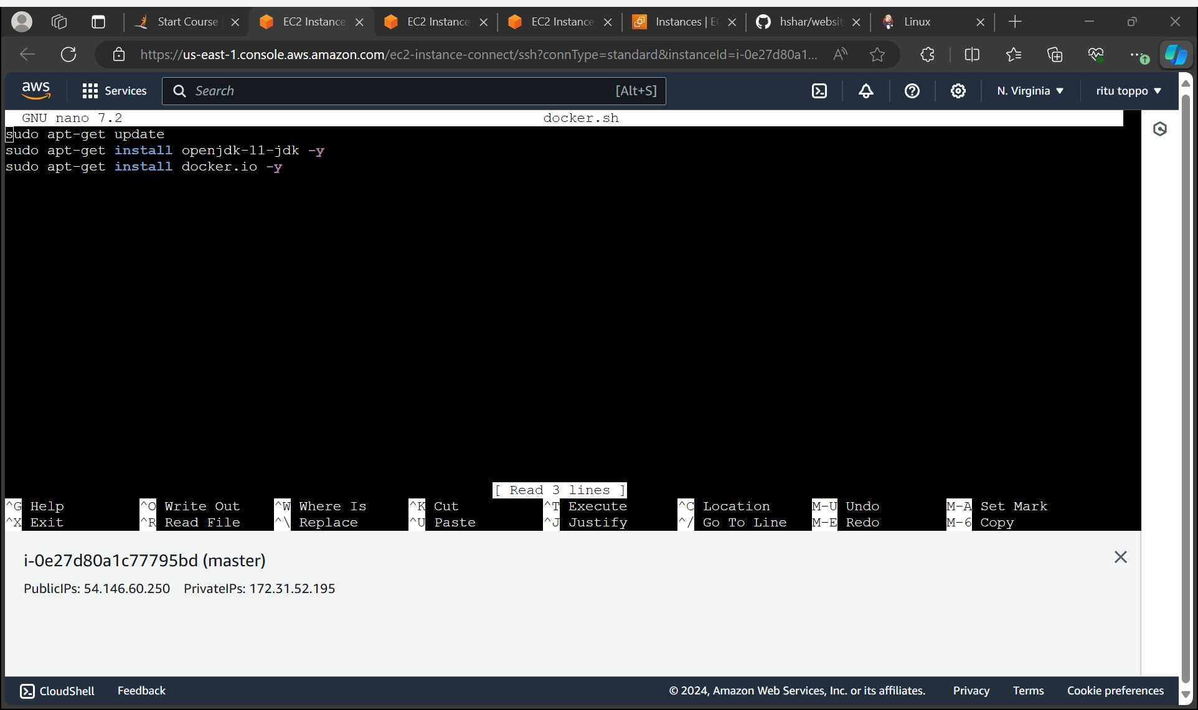
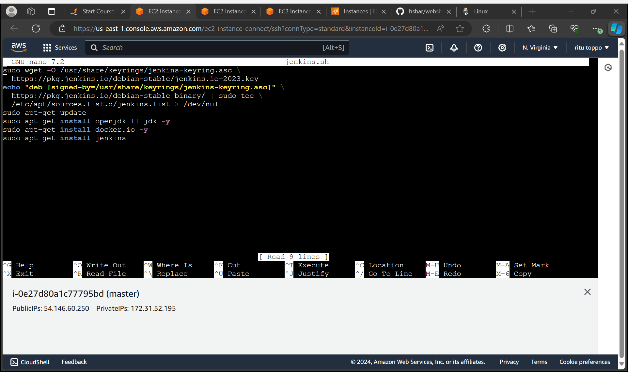
Created a docker.sh and Jenkins.sh file

Slide 11
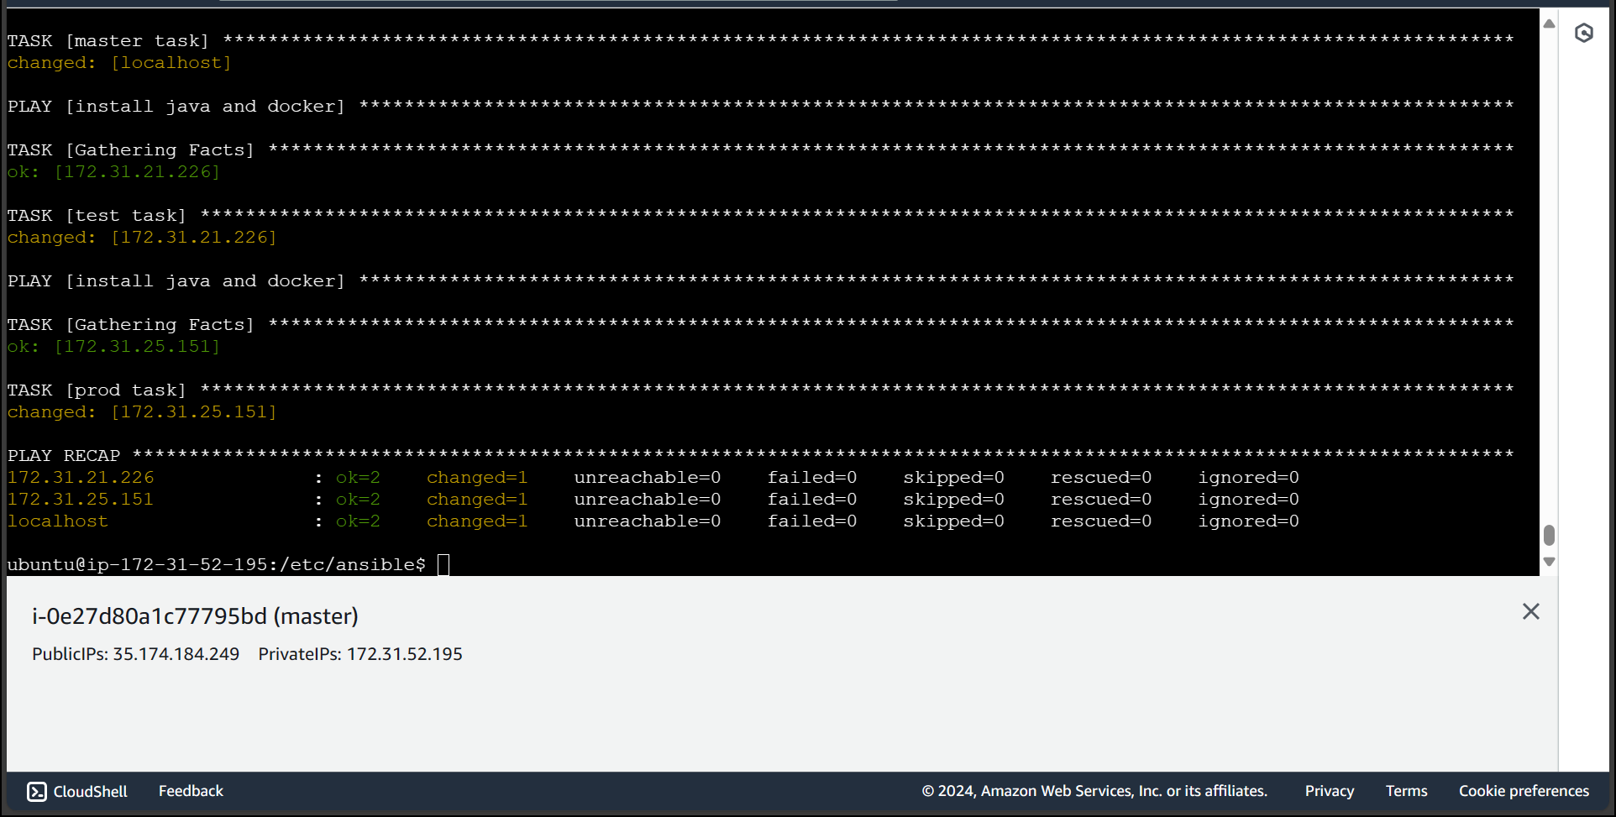
Syntax Checking and executing the playbook install.yaml successfully installed

Slide 12
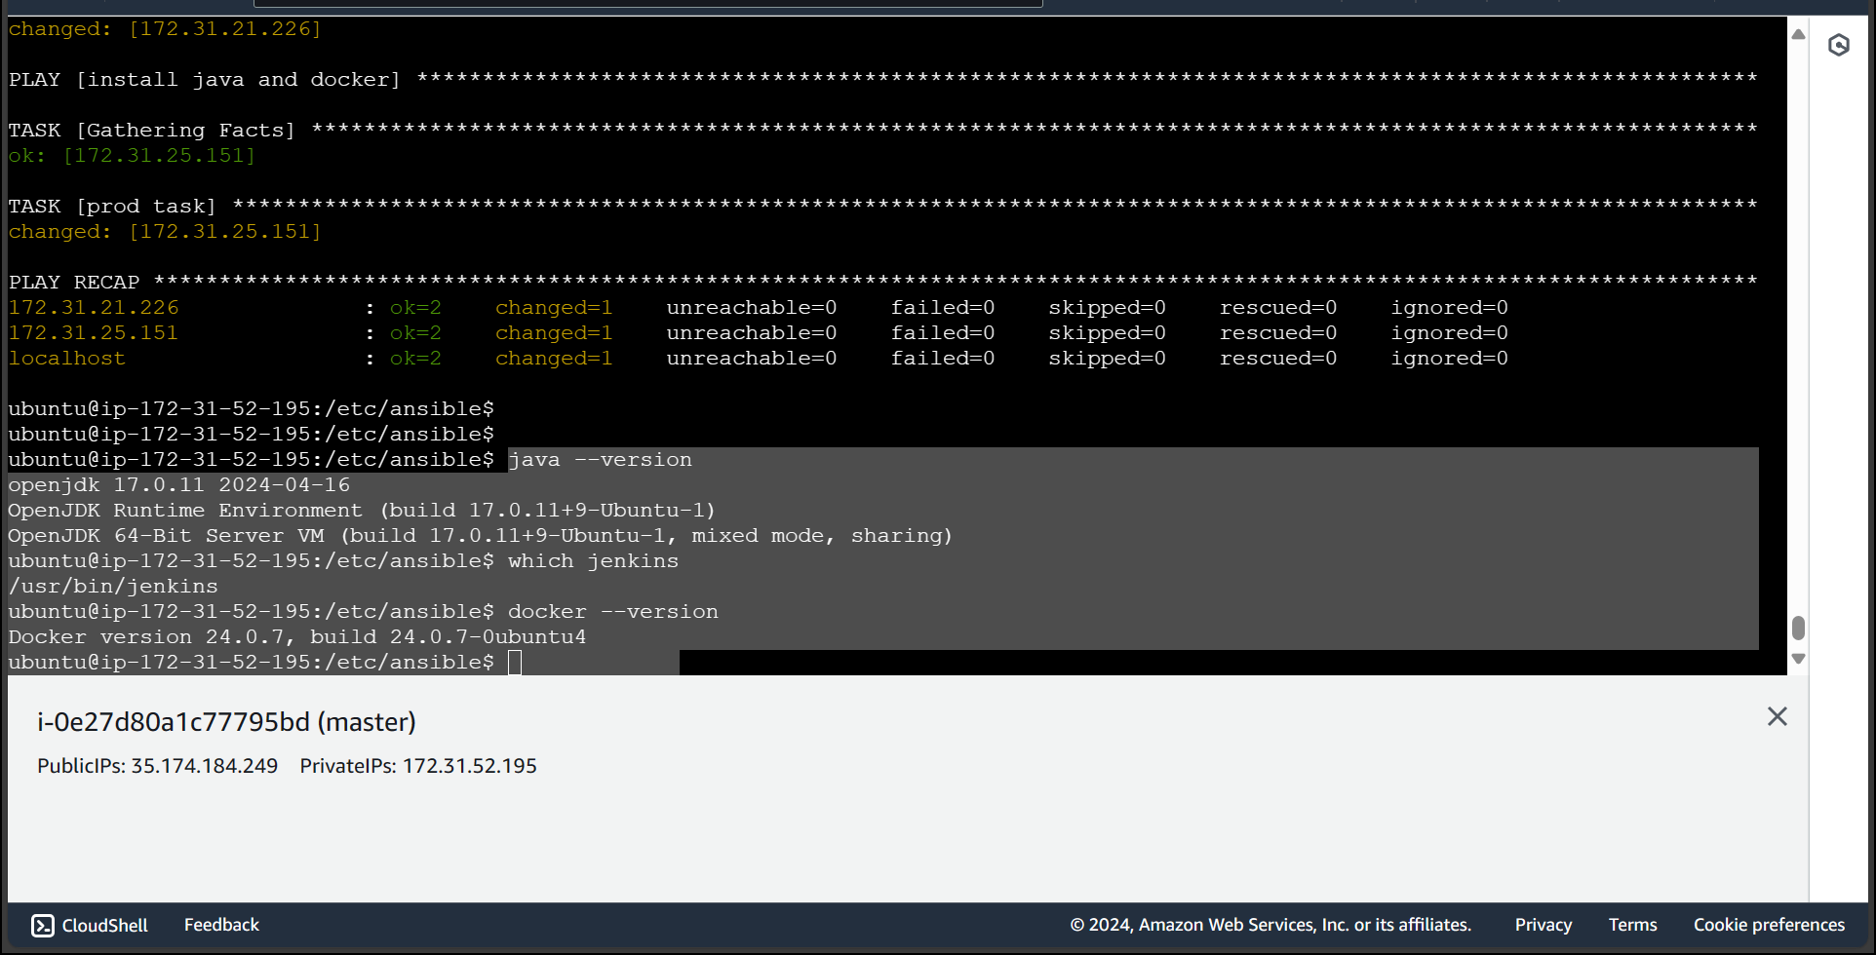
Checking the installation of Java, Jenkins and docker in master successfully installed

Slide 13
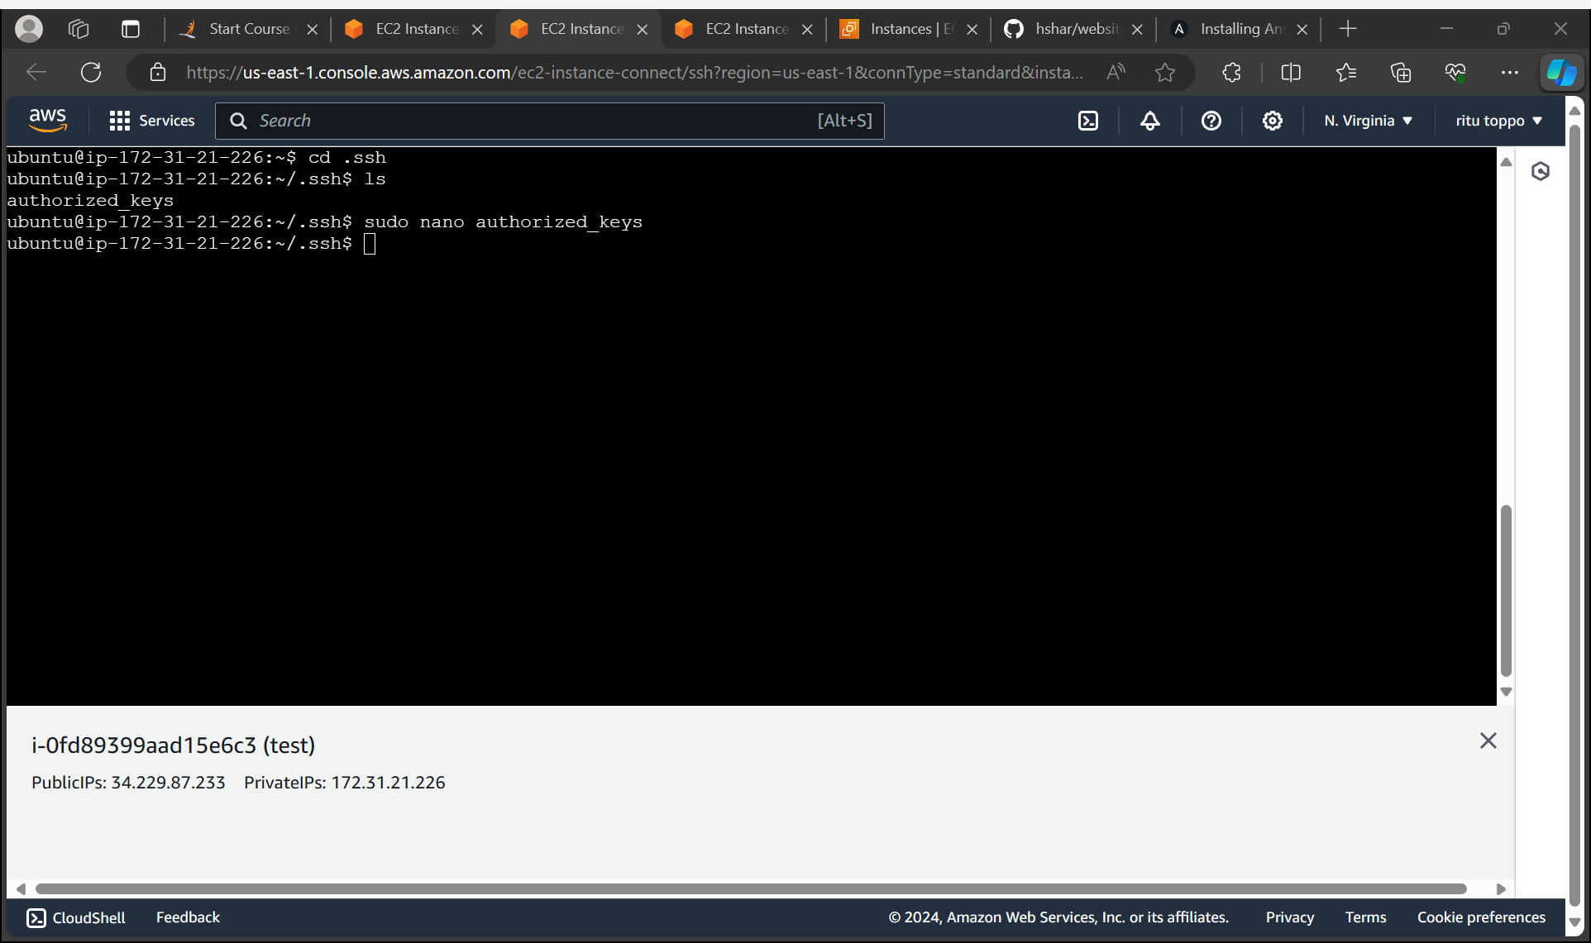
Adding public key ssh connection in test instance

Slide 14
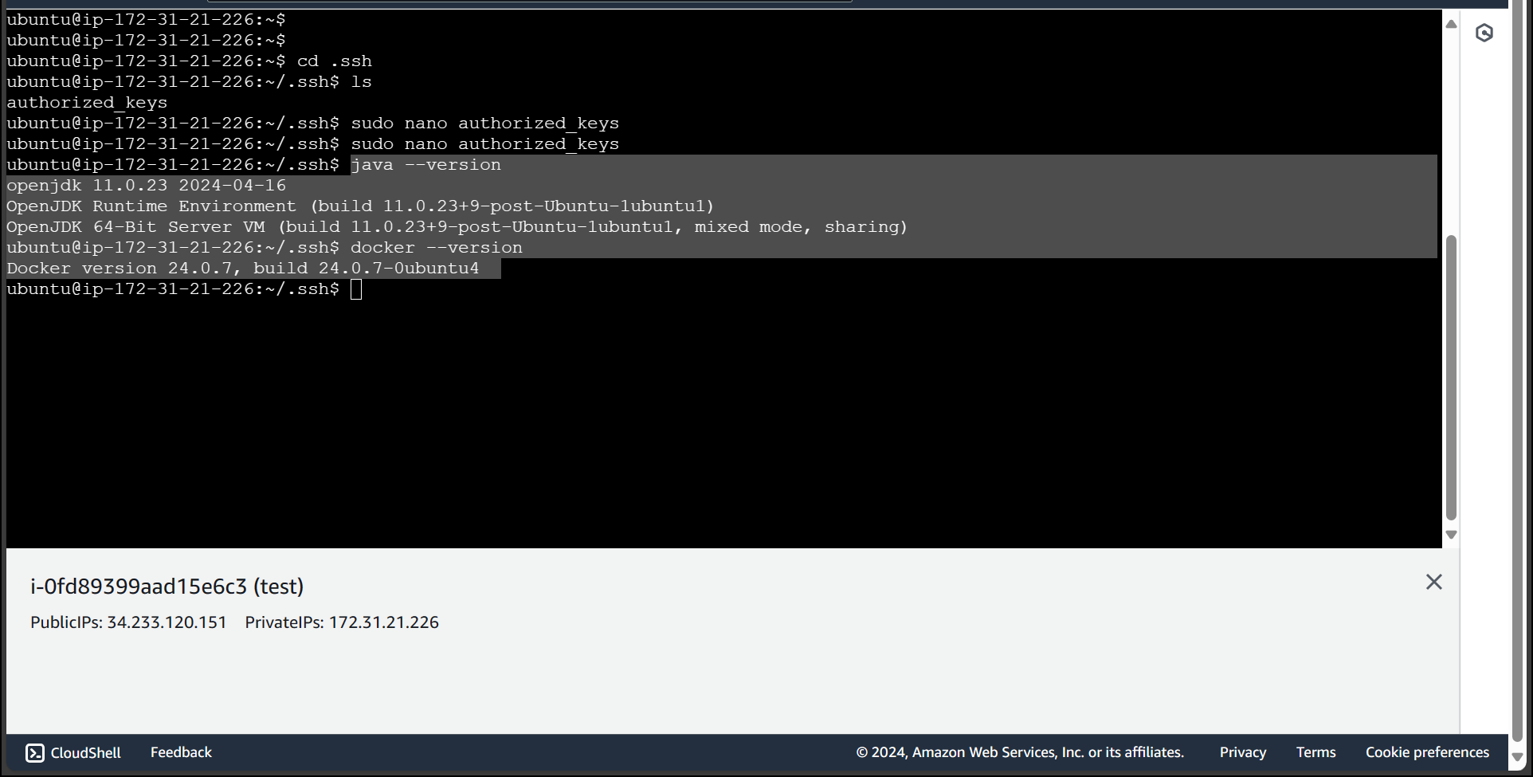
Checking the installation of Java, Jenkins and docker in test

Slide 15

prod instance ssh connection with master

Slide 16
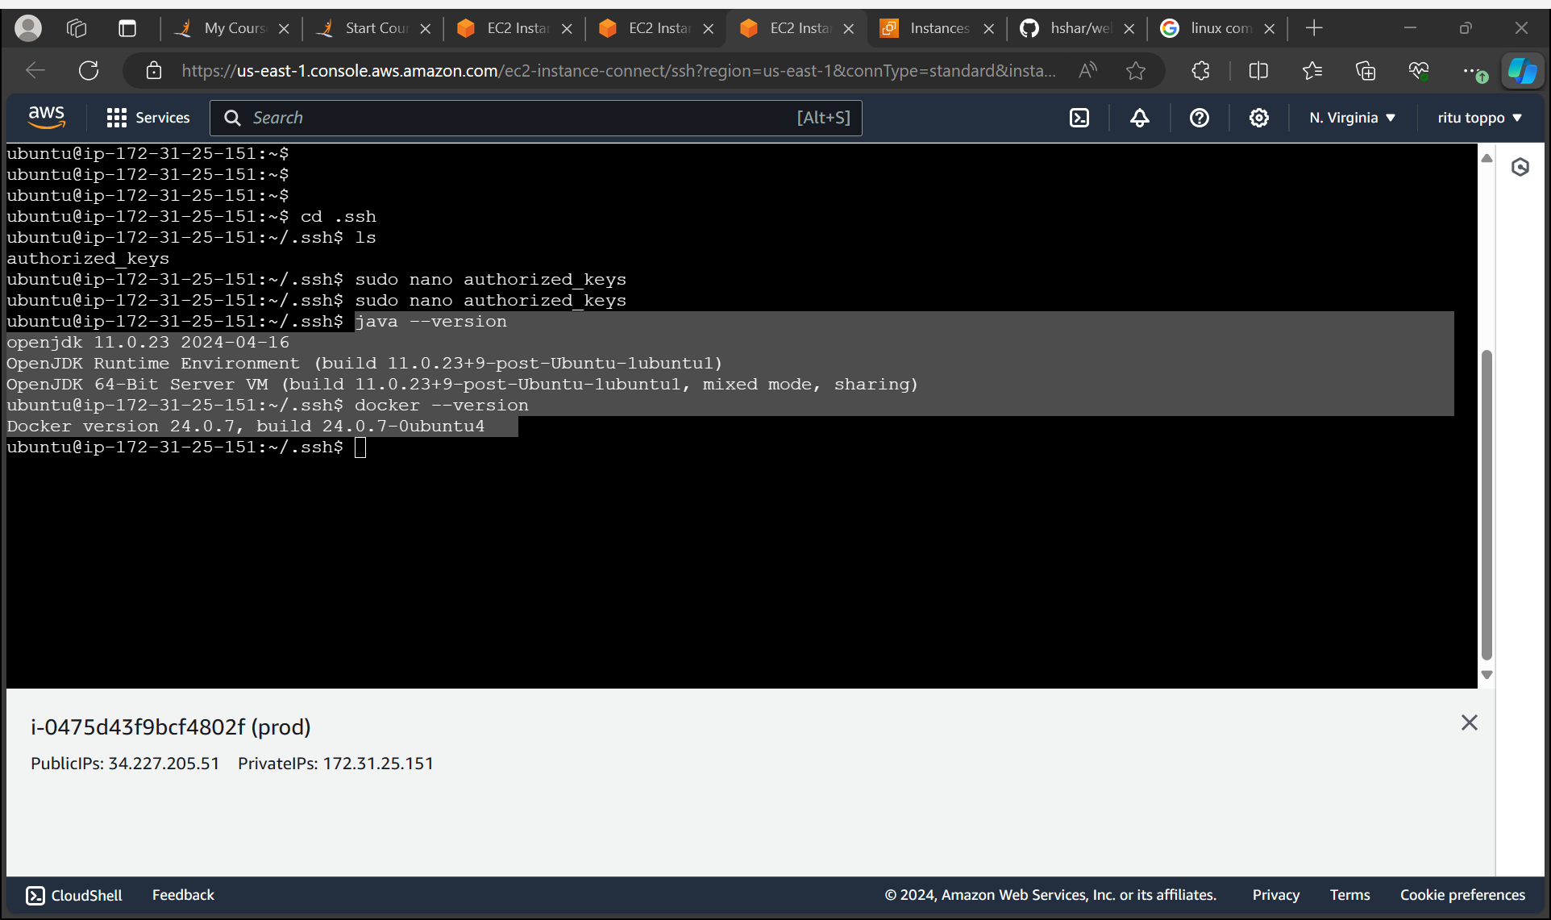
Checking the installation of Java and docker in prod

Slide 17
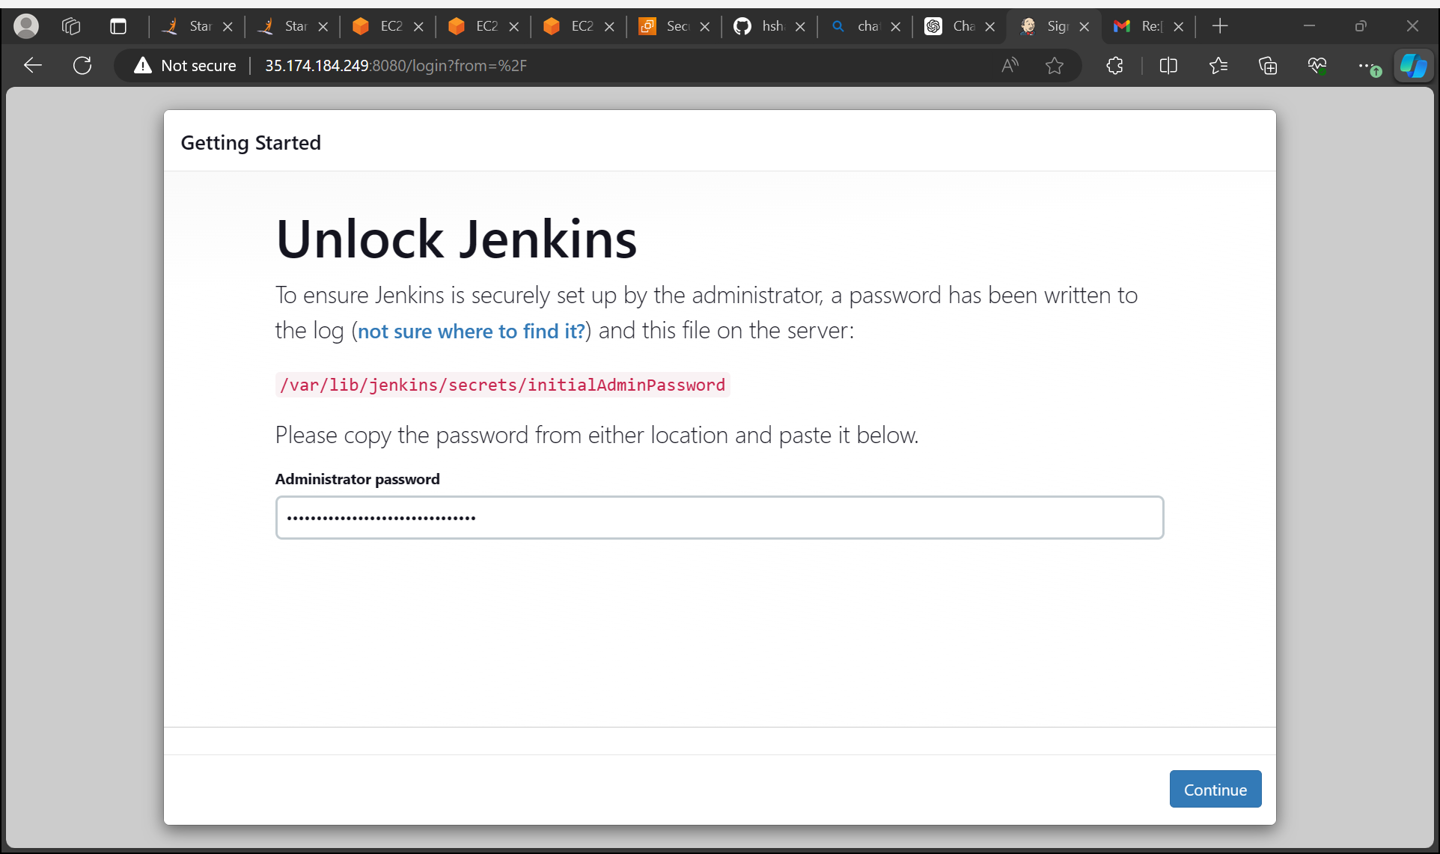
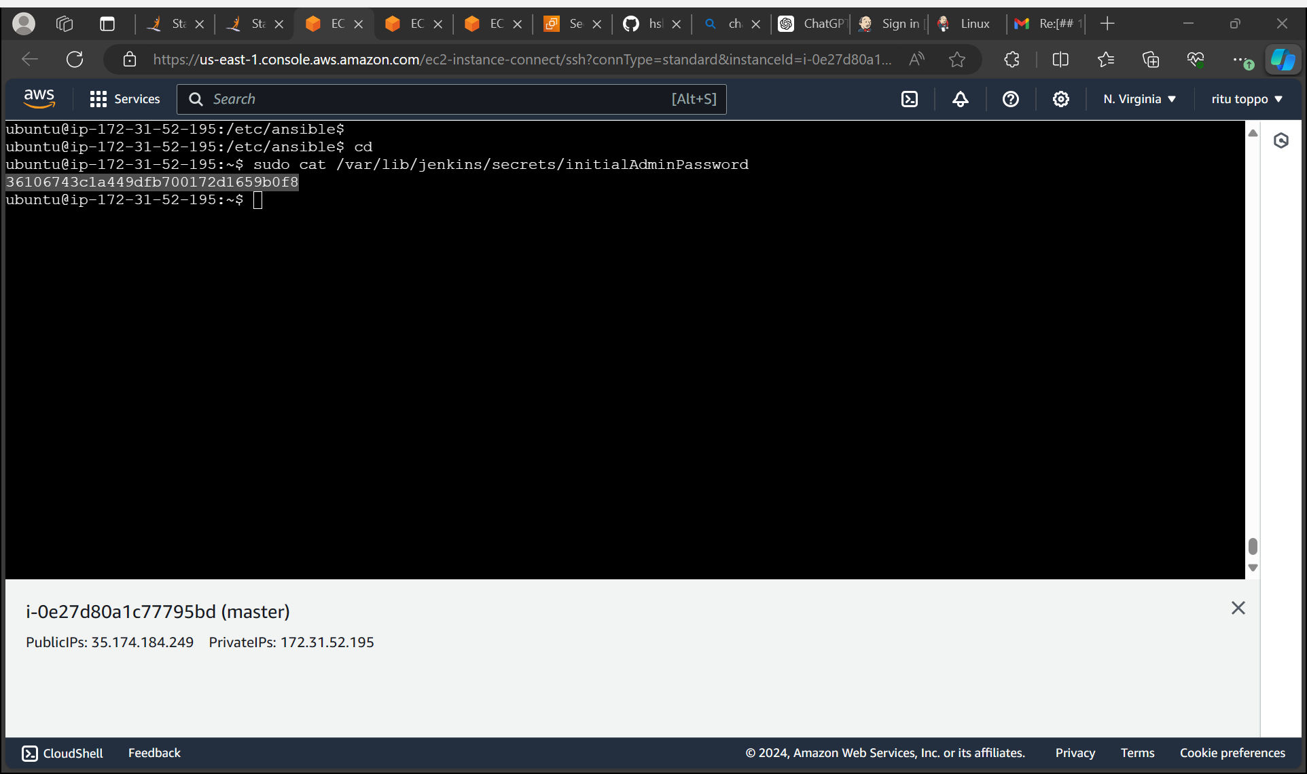
Login to Jenkins

Slide 18
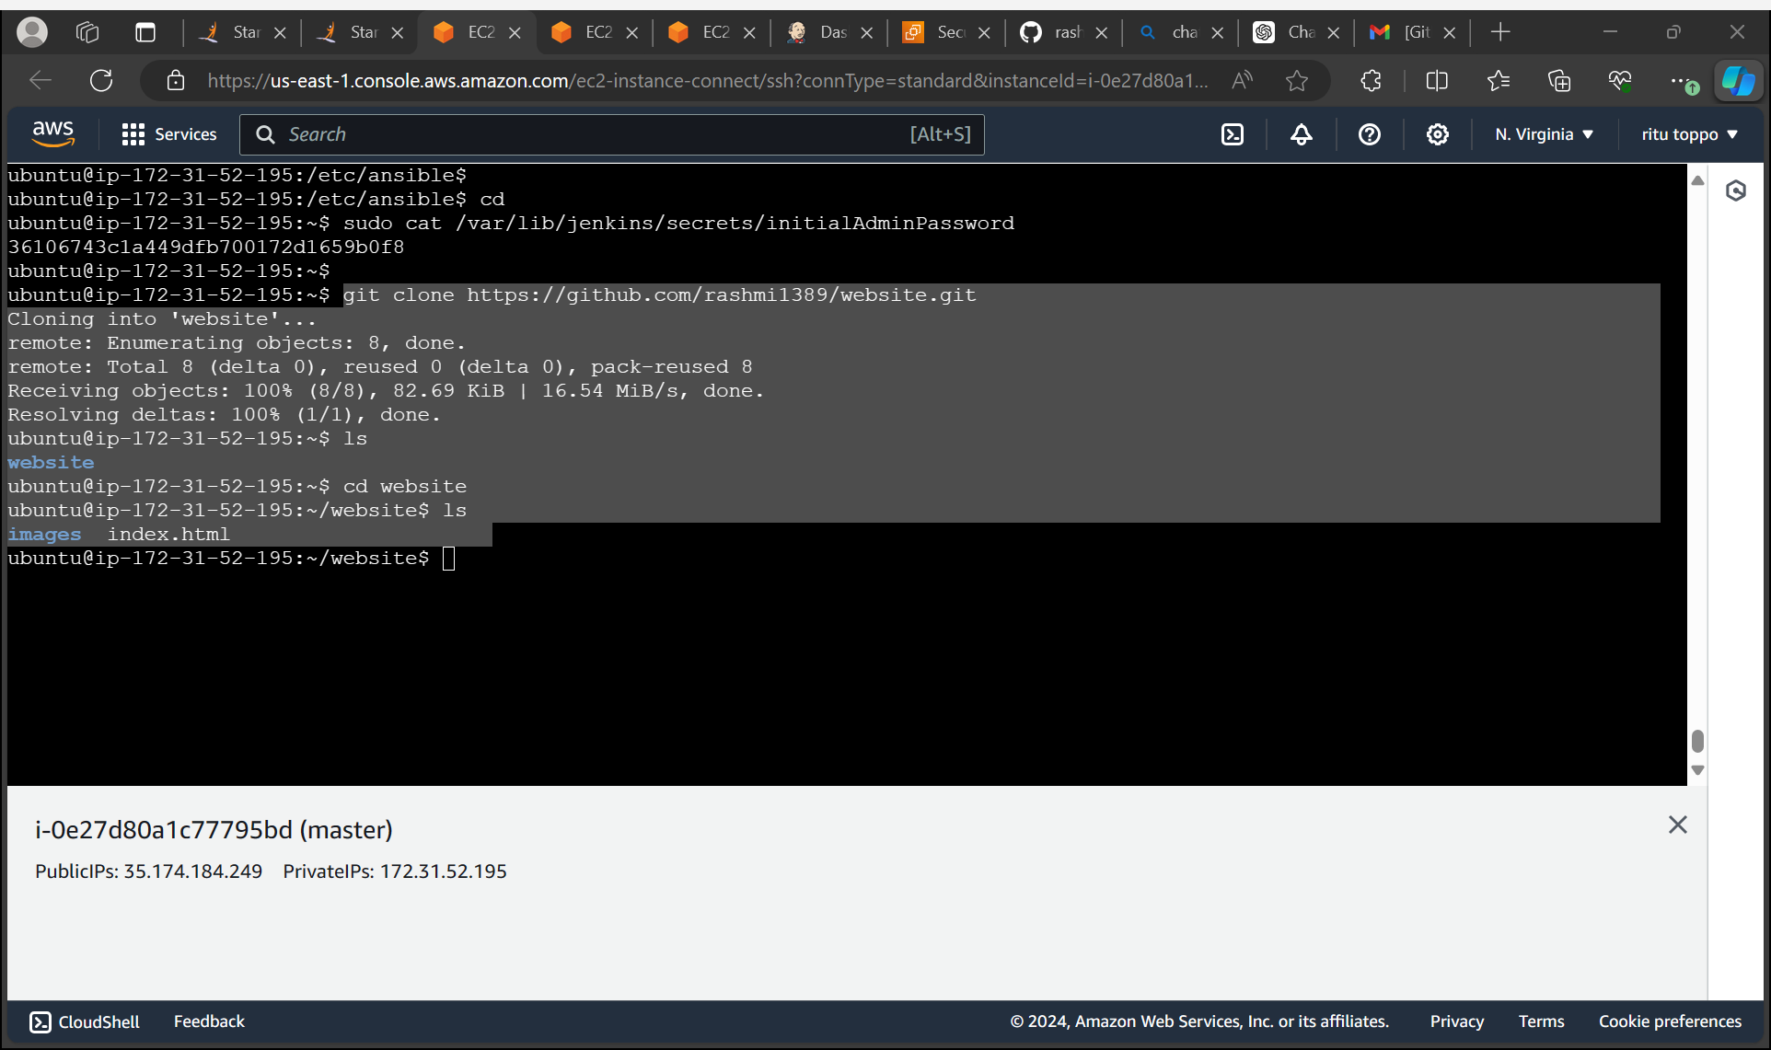
Clone the git repository in master with the given url in project

Slide 19
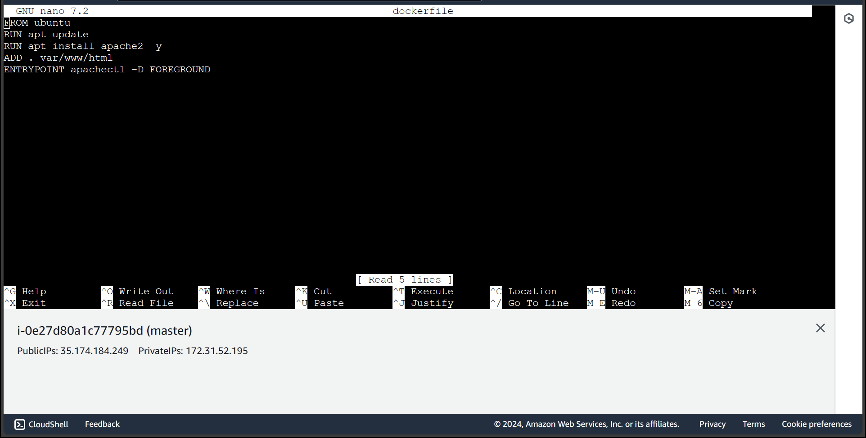
Create a docker file in master

Slide 20
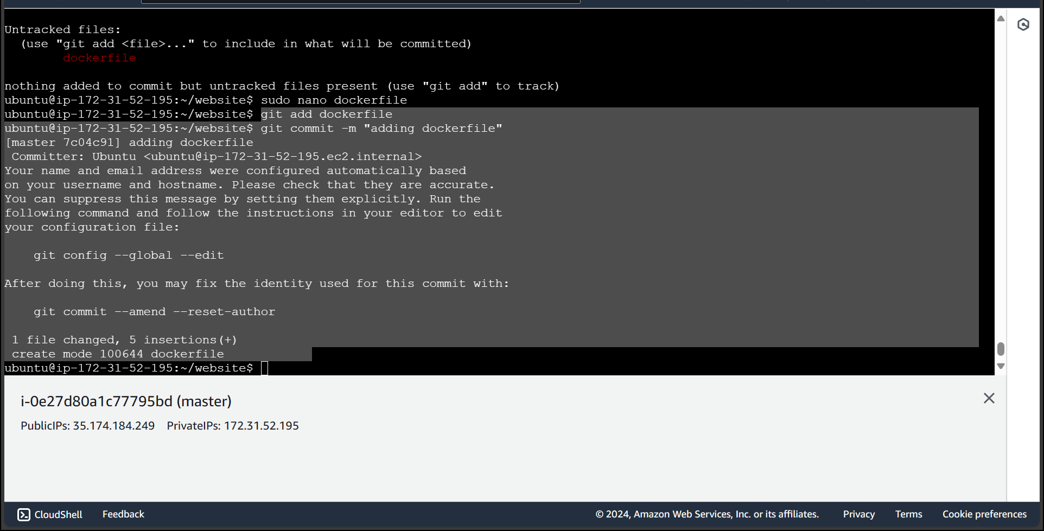
Add the file in git

Slide 21
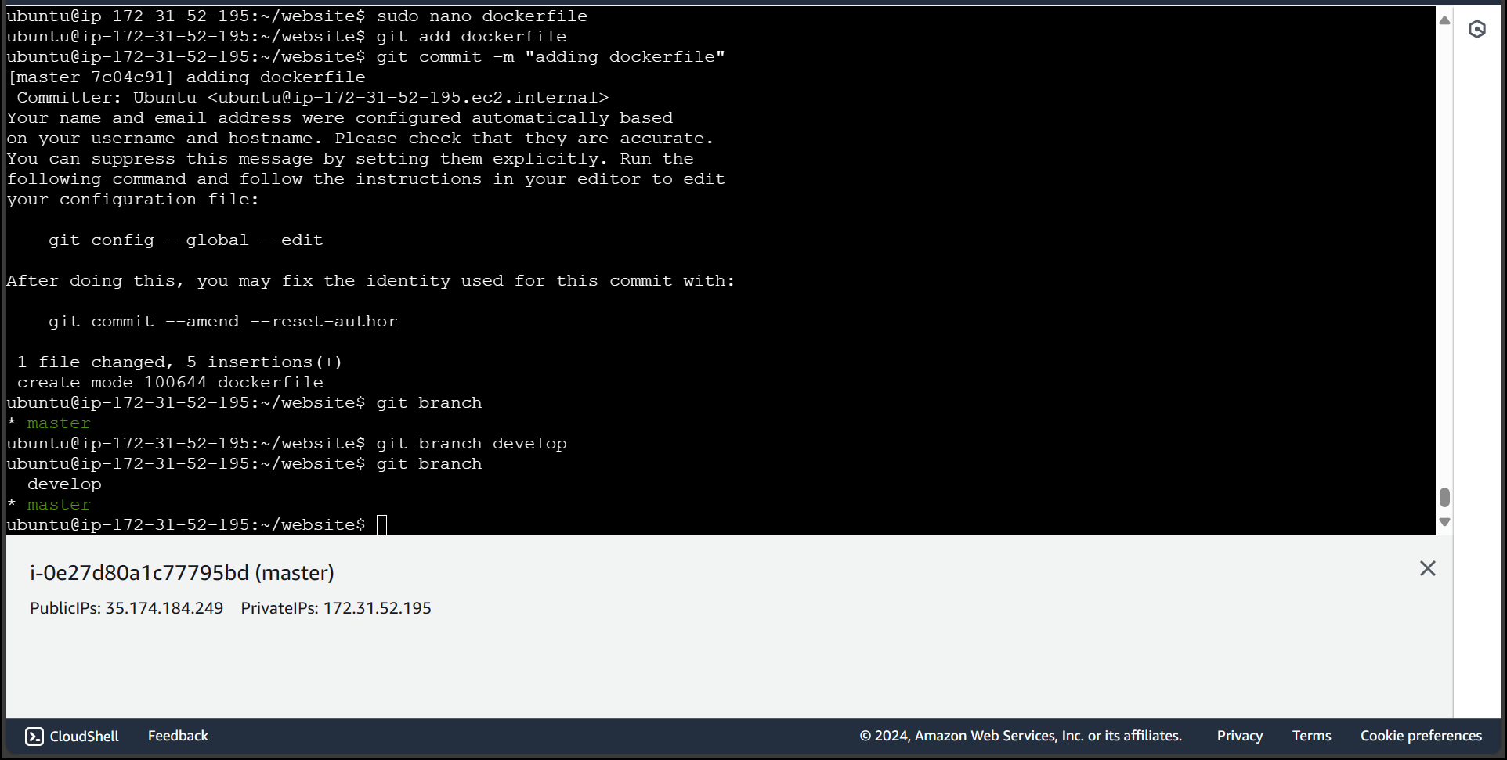
Create a develop branch

Slide 22
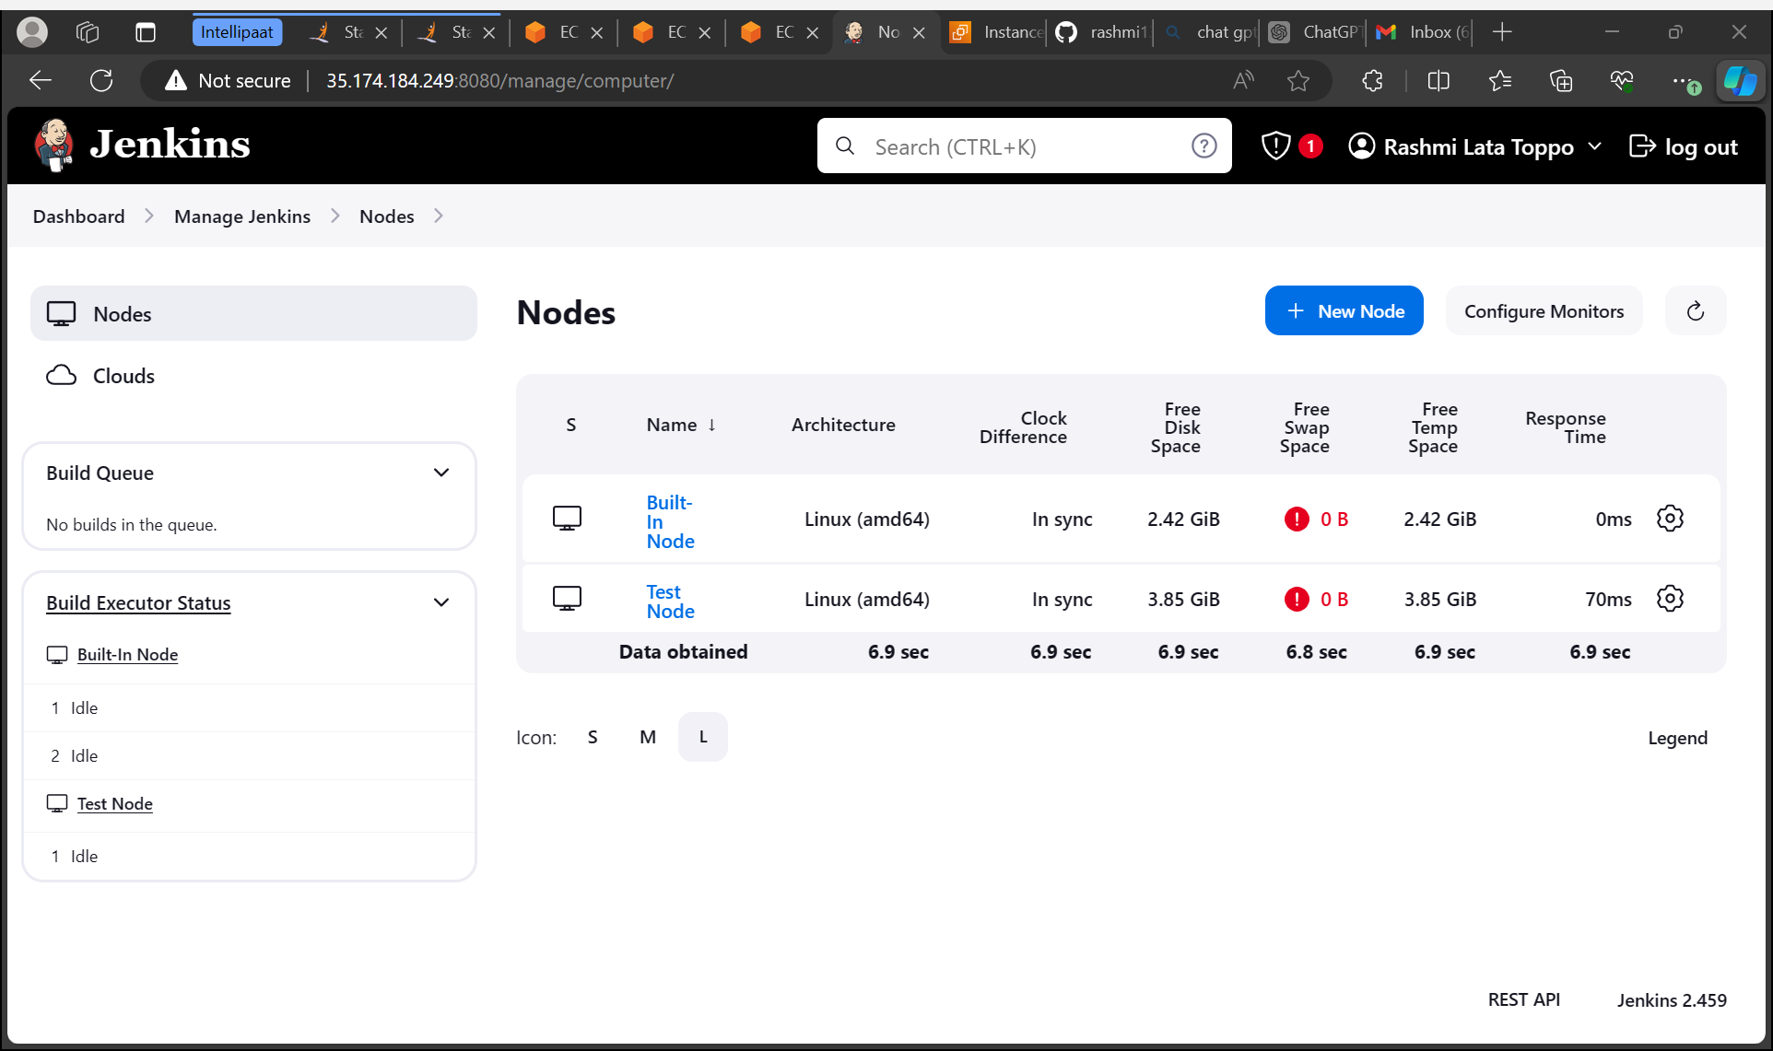
Connect the test instance to Jenkins as test node

Slide 23
Connect the prod instance to Jenkins as prod node

Slide 24
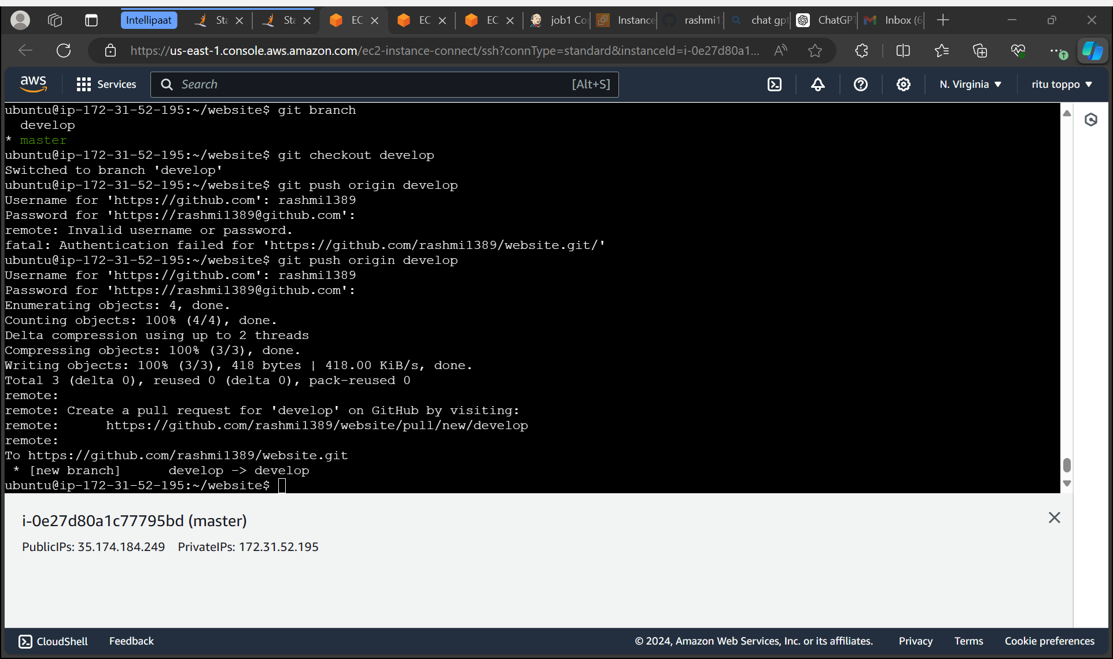
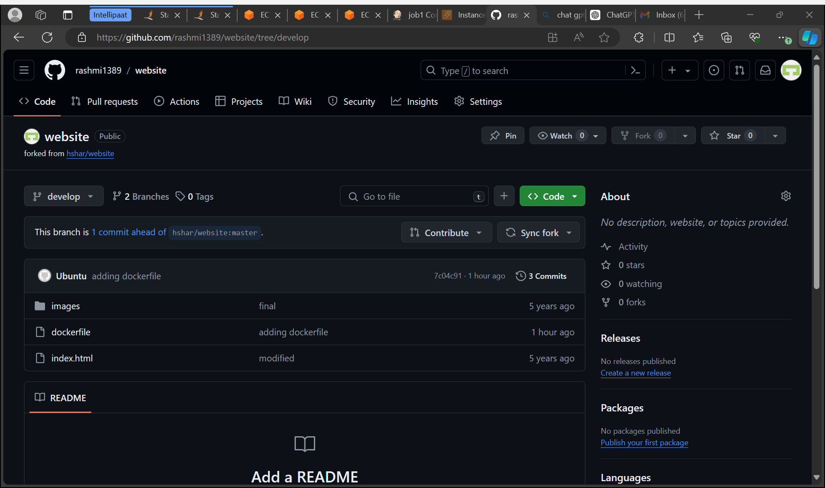
Push the dockerfile to develop branch

Slide 25
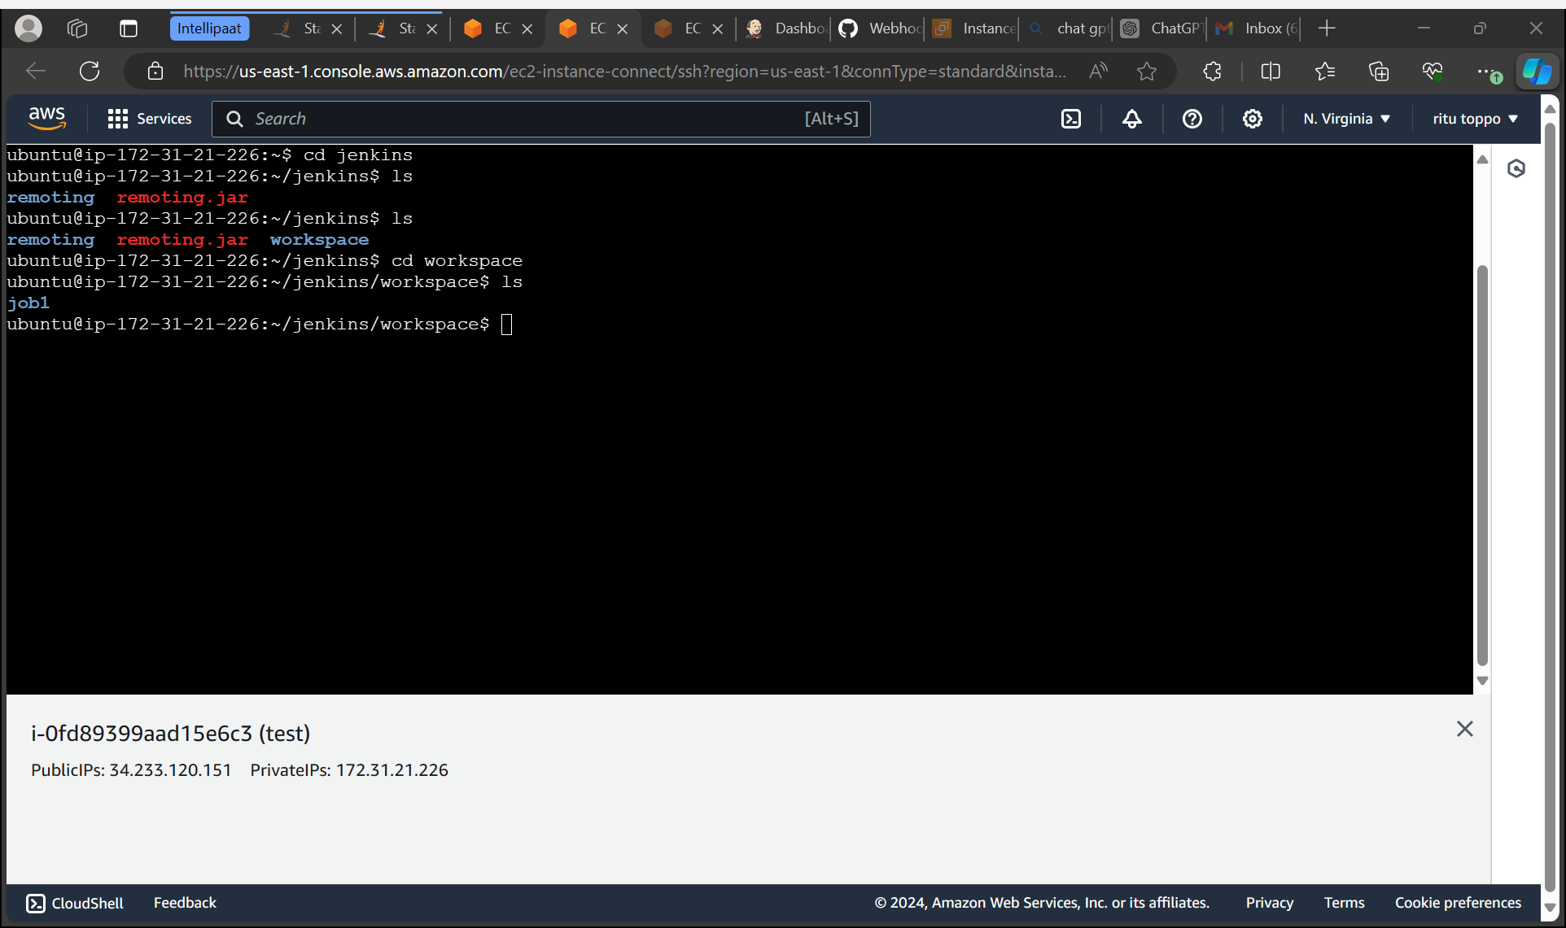
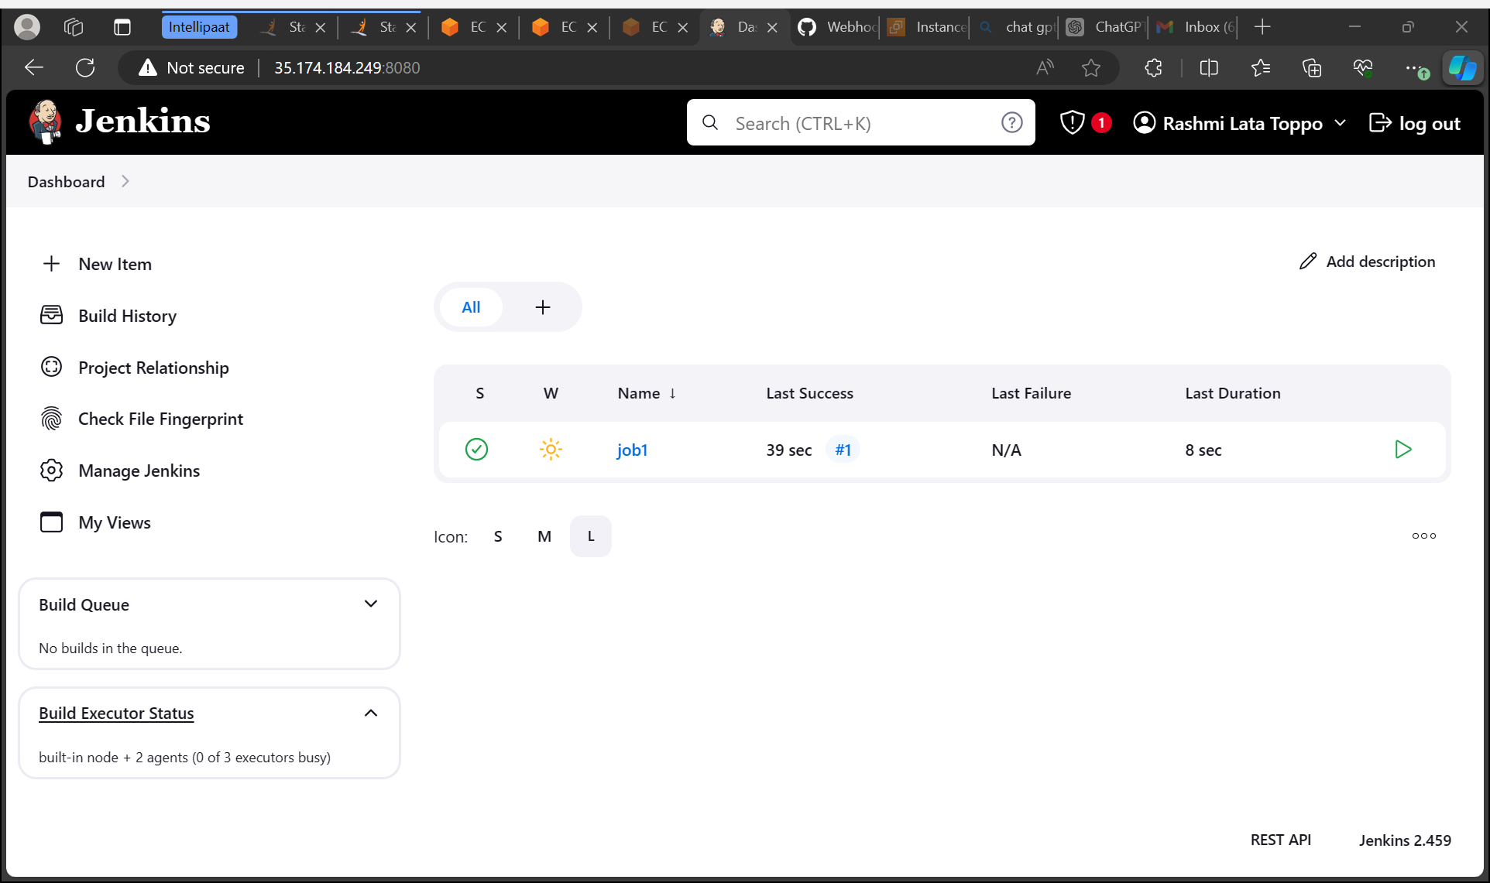
Now create a new job1 and build is successful checking in test instance

Slide 26
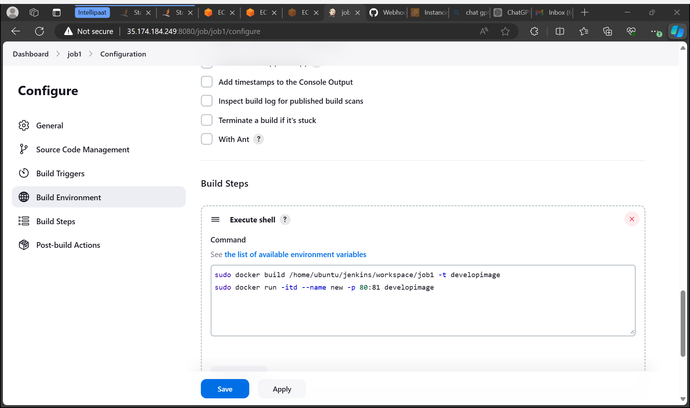
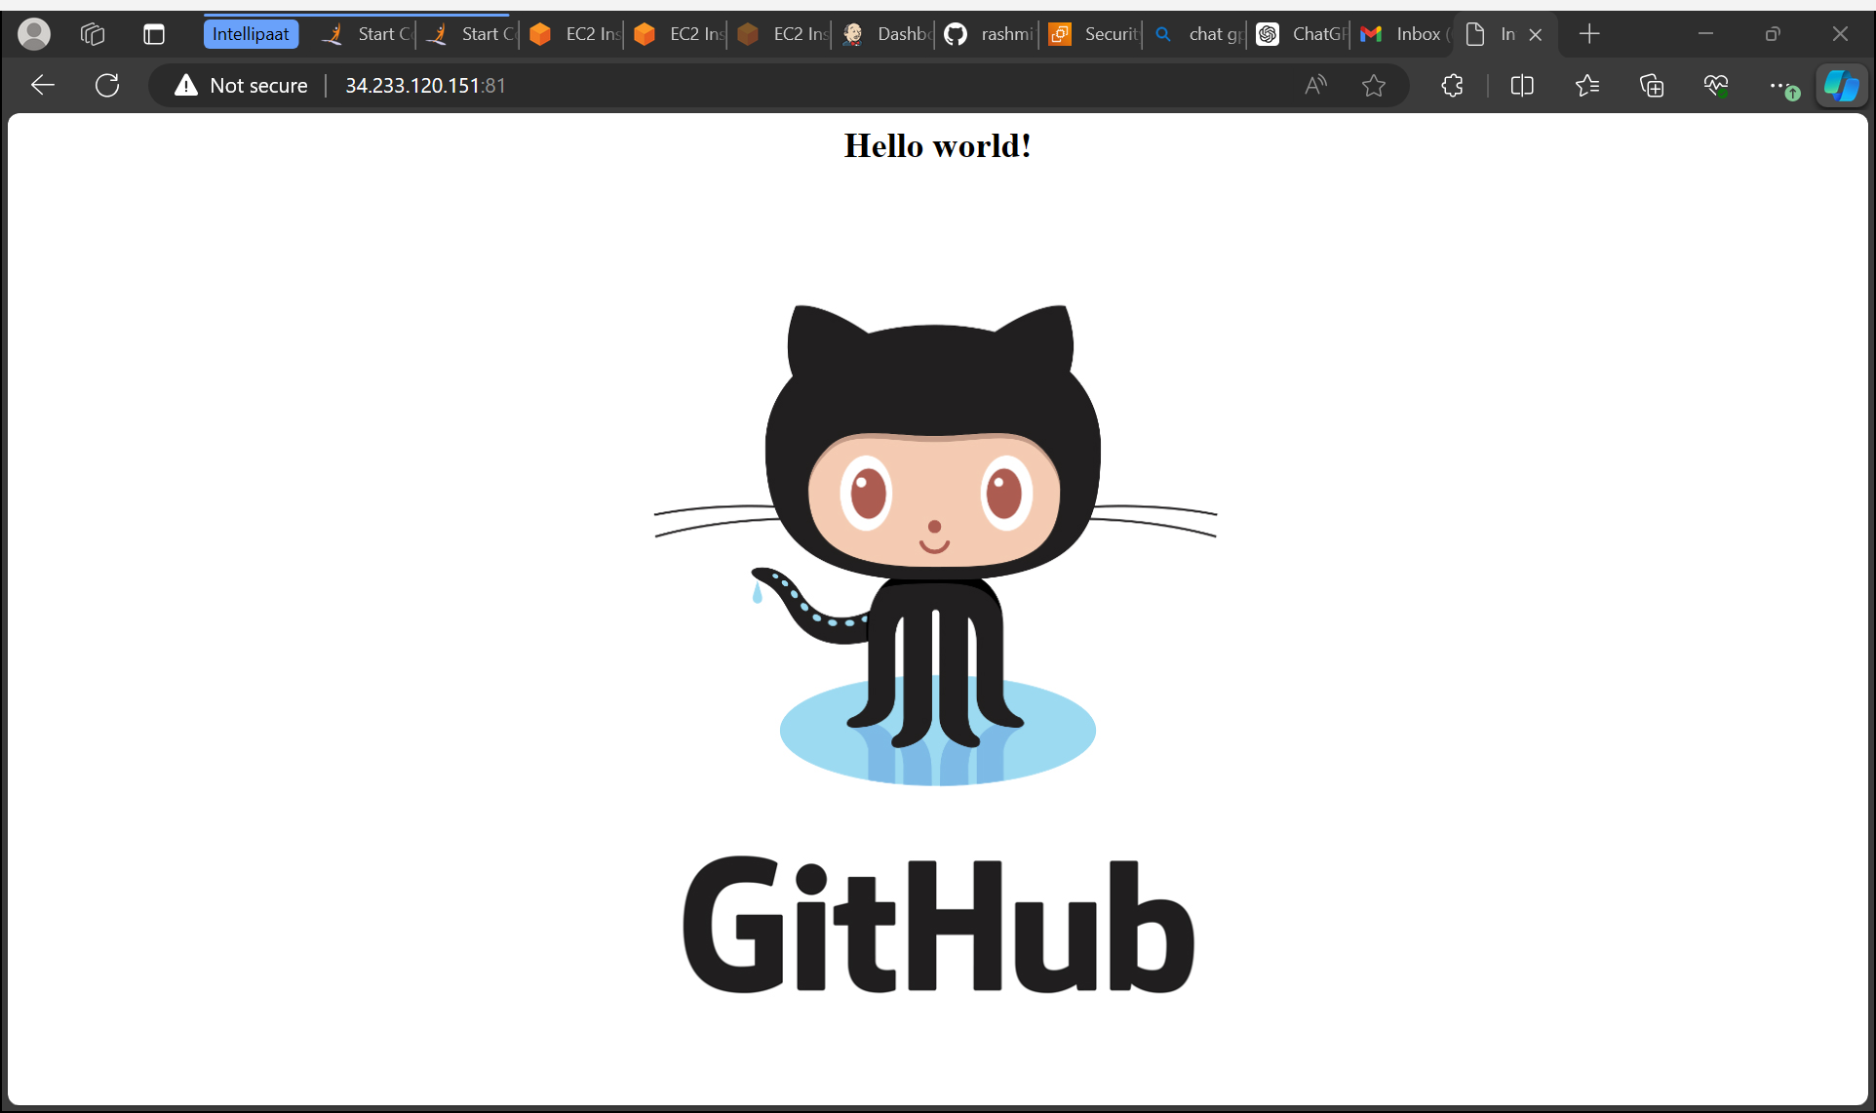
Build a container so that our job is running on local host or not

Slide 27
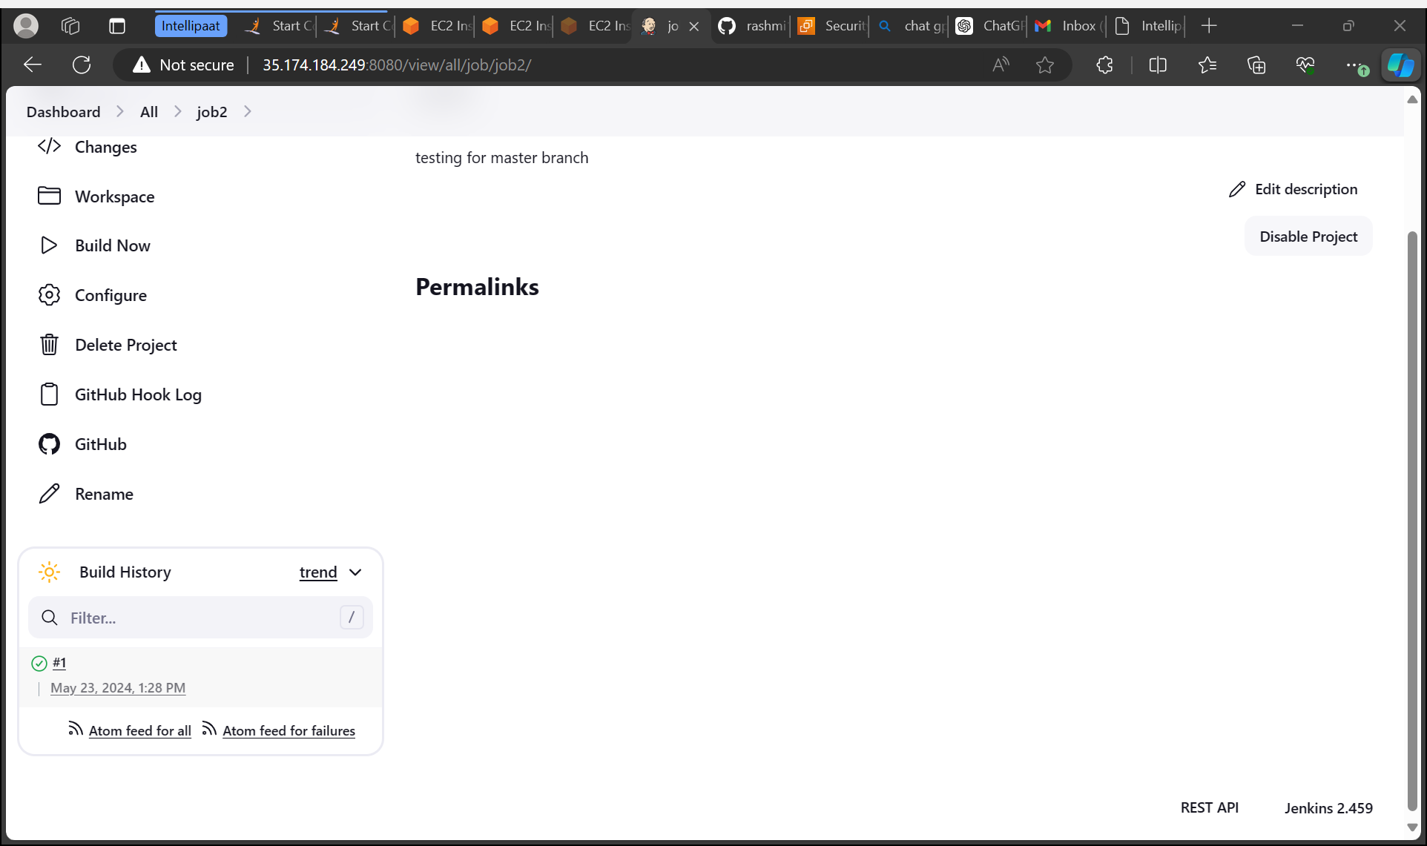
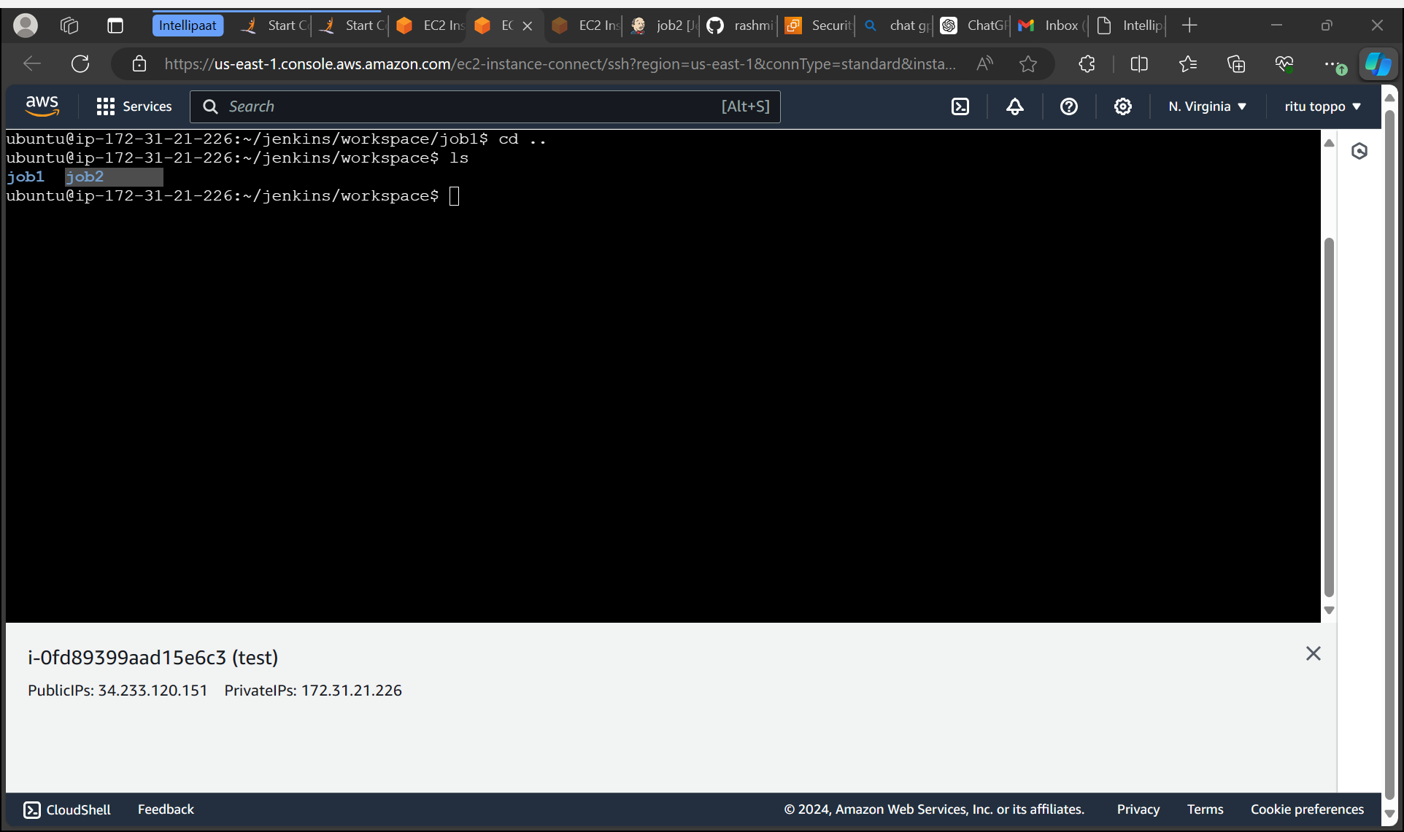
Now create a new job2

Slide 28
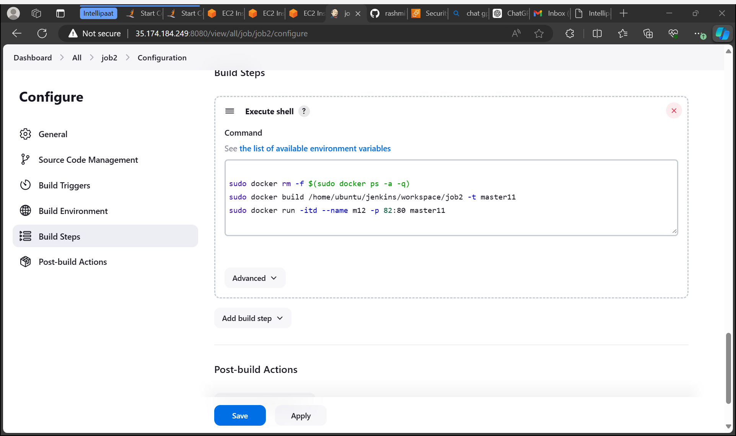
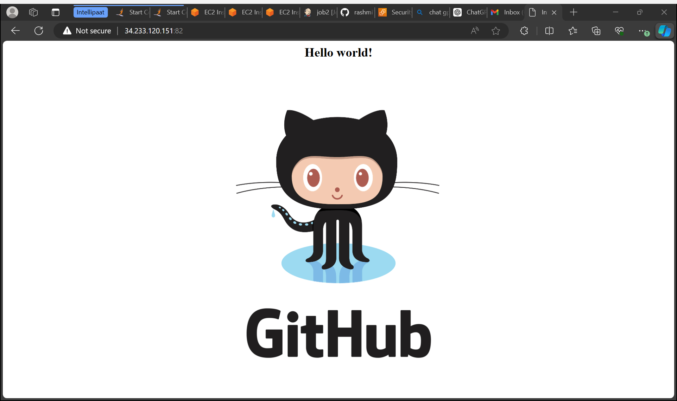
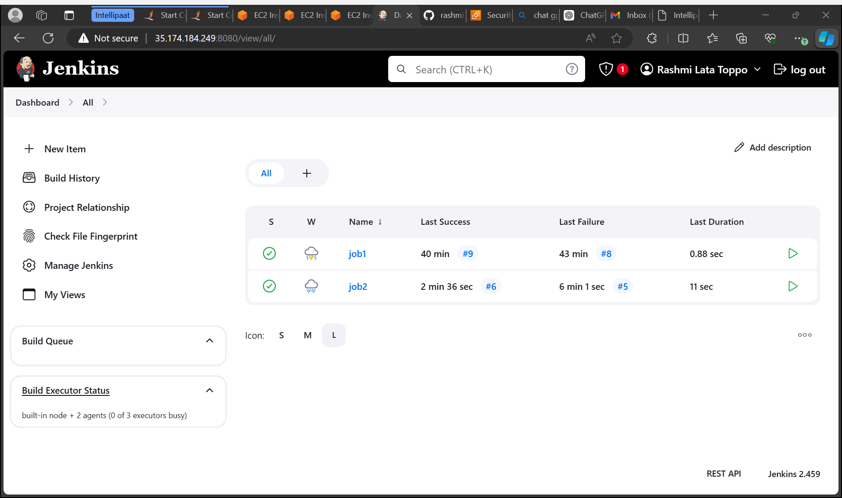
Build a container so that our job2 is running on local host or not

Slide 29
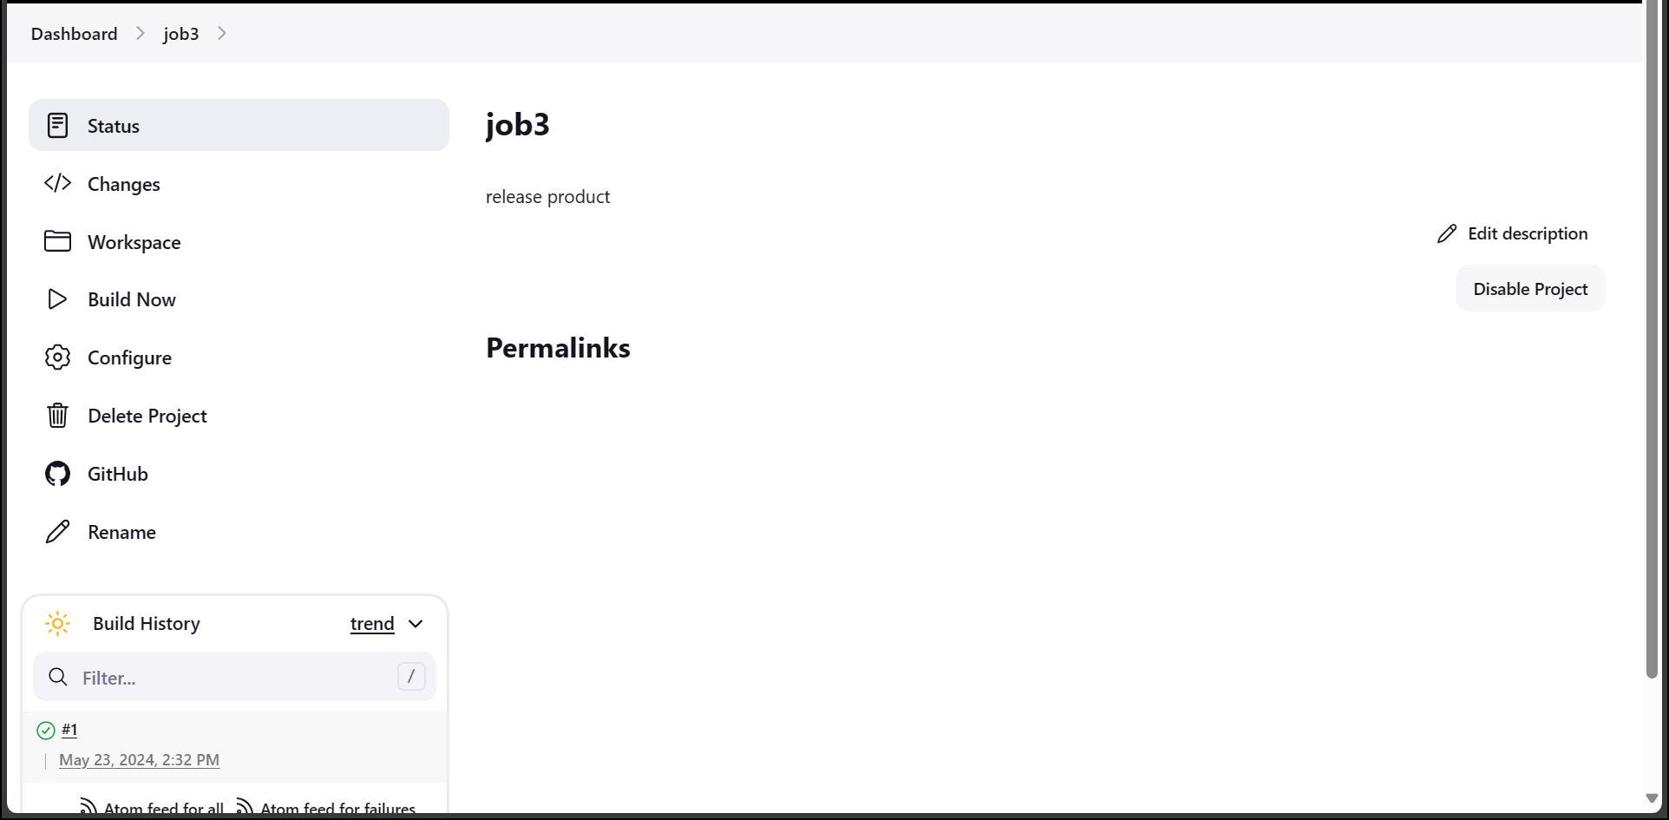
Now create a new job3 and build is successful

Slide 30
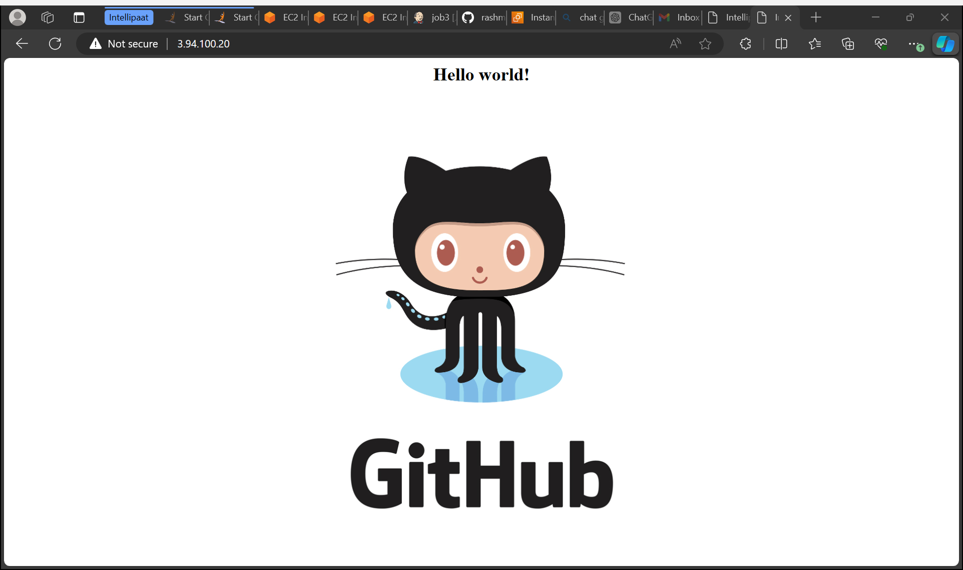
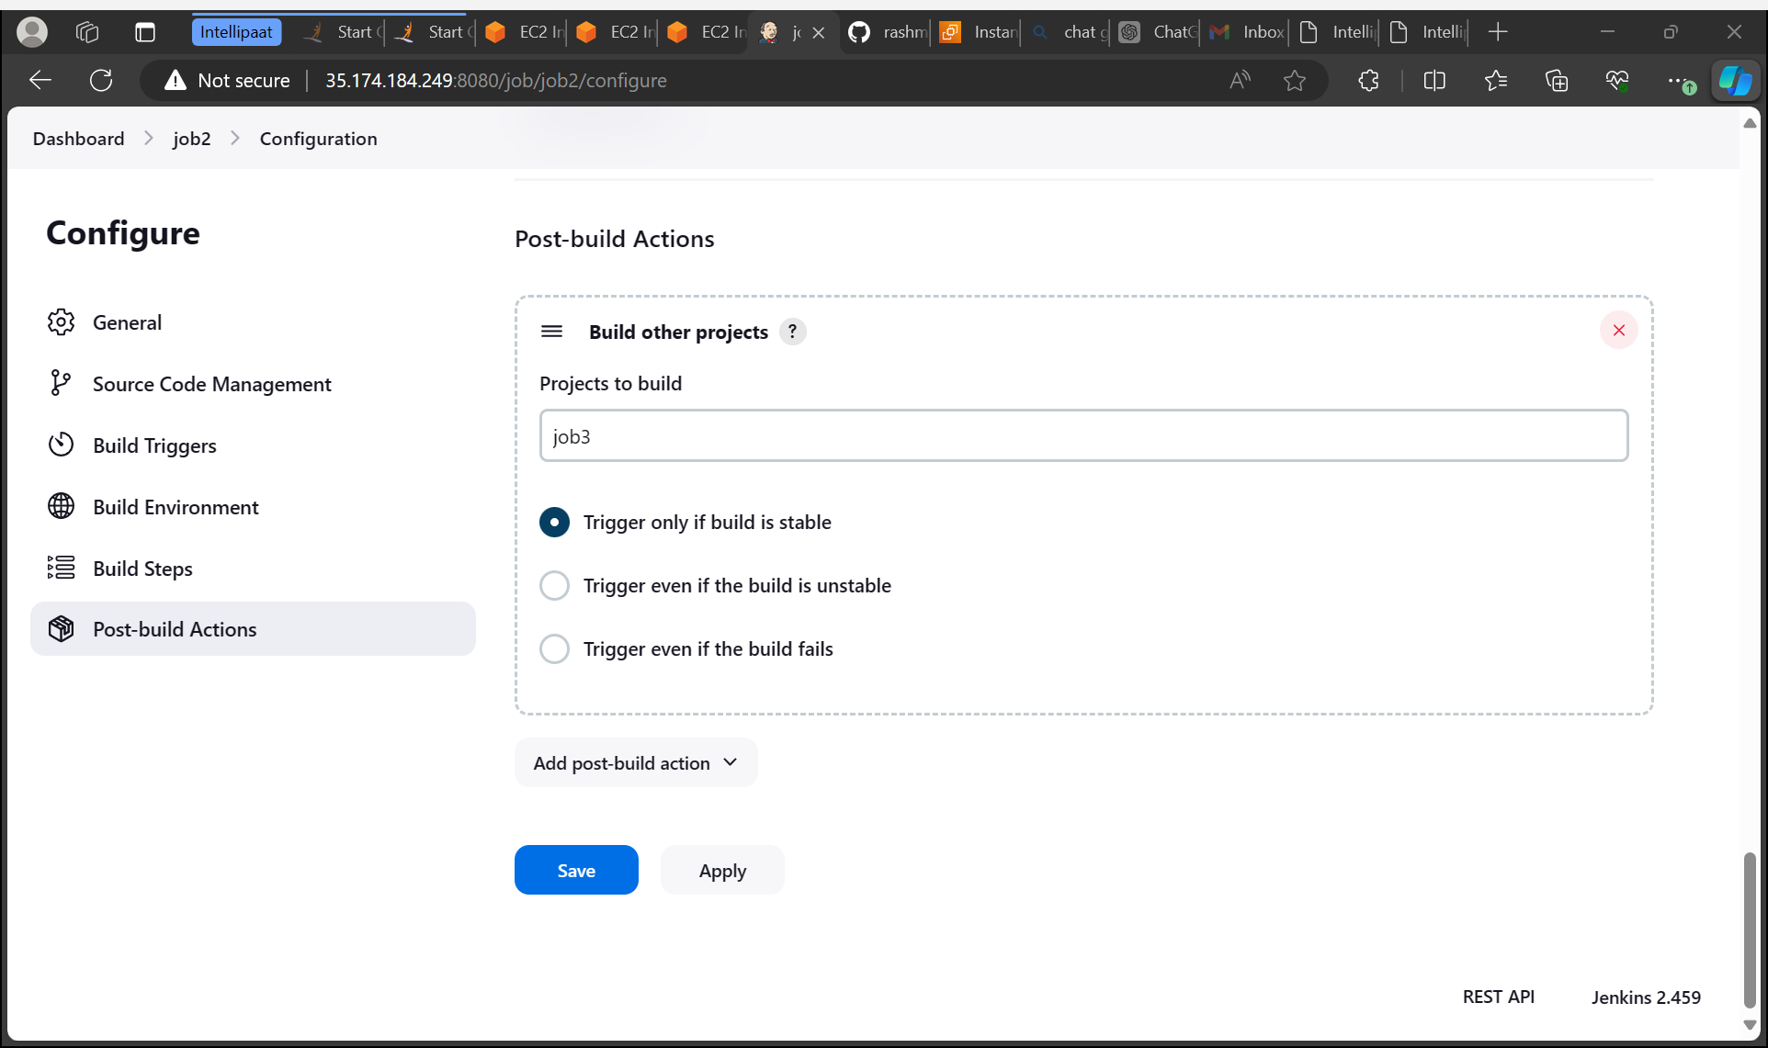
Build a container so that our job3 is running on local host or not

